Slide 1
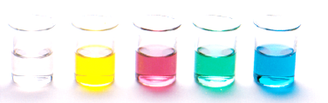
Oxidation of Organic Compounds
Reactions of functional groups – Oxidation reactions
Combustion reaction
Partial and Complete oxidation of alchols
Resources
Essential chemistry, ch 12.1 – 12.2
Essential chemistry Set 17

Slide 2
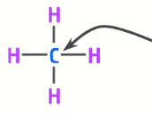
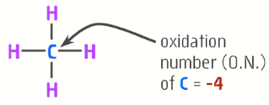
Oxidation of Organic Compounds
Oxidation is defined as loss of electrons
In organic chemistry this is typically seen as a molecule gains oxygen or loses hydrogen
This results in the oxidation number of carbon changing
O.N. of C = ?
Remember O.N. of Oxygen is -2 and hydrogen is +1

Slide 3
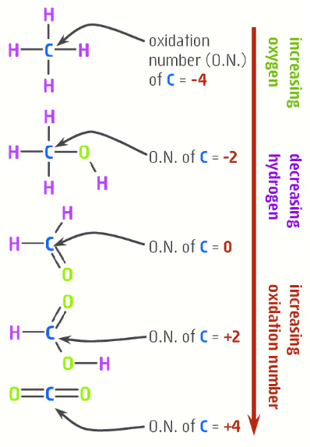
Oxidation of Organic Compounds
Increase in O.N confirms that the carbon, therefore the molecule, has been oxidised.
Many compounds are oxidised from exposure to oxygen in the air
E.g. ethanol in the presence of air slowly oxidises to ethanoic acid (acid acid) – the main component of vinegar. Notice CH₃COOH has gained oxygen, lost hydrogen and O.N. of the carbon has increased from -2 to 0

Slide 4
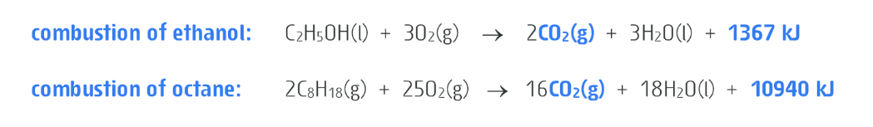
Combustion
The combustion of ethanol also involves aerial oxidation
The equations above show the complete combustion of octane and ethanol (major components in fuels
The carbons involved gained oxygen, lost hydrogen and increased its oxidation number
It is called a complete oxidation as CO₂ cannot gain any more oxygen, has no more hydrogens to lose and carbon has the highest possible O.N. of +4

Slide 5
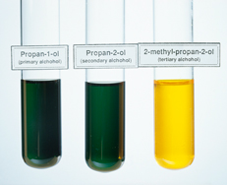
Oxidation of alcohols
Combustion converts organic compounds into inorganic compounds, CO₂ and H₂O
In the laboratory we do controlled oxidations of alcohols to create other useful organic compounds – you did this yourself in Experiment 31!
In experiment 31 – we made aldehydes, a ketone and a carboxylic acid using what oxidizing agent?
Acidified dichromate (Cr₂O₇²⁻)
Acidified permanganate (MnO₄⁻)

Slide 6
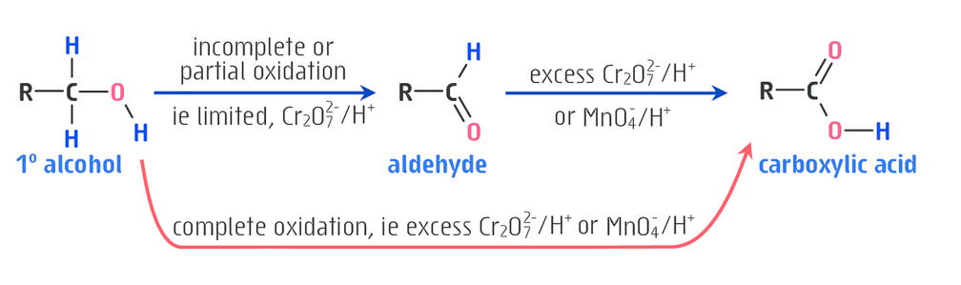
Oxidation of Alcohols
Primary alcohol can undergo a partial oxidation to give an aldehyde or a complete oxidation to give a carboxylic acid.
Partial oxidation requires an excess of alcohol to be used, a weaker oxidizing in this case dichromate, and the mixture is warmed so the aldehyde evaporates as it forms (remember the smell?)

Slide 7
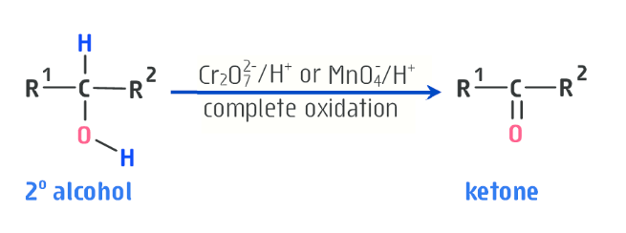
Oxidation of Alcohols
Secondary alcohols are oxidised to ketones
Ketones resist further oxidation, they are the final product of this reaction

Slide 8
Oxidation of Alcohols
What happened when we reacted acidified dichromate or permanganate with a tertiary alcohols?
Nothing happened, solutions’ colour stayed the same
Tertiary alcohols resist oxidation, they do not react with acidified dichromate (Cr₂O₇²⁻) or acidified permanganate (MnO₄⁻)

Slide 9
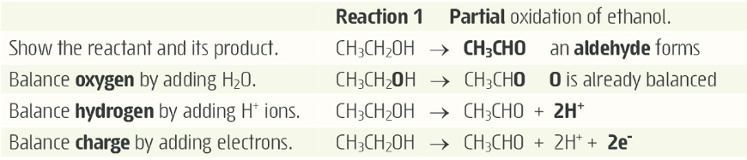
Half equations
Write half-equations in the usual way

Slide 10
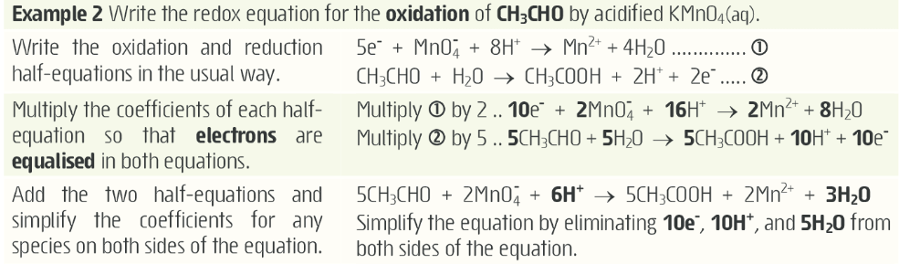
Half equations

Slide 11
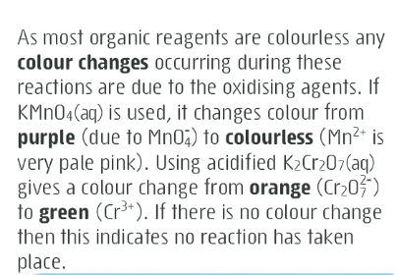
On going work
Complete Experiment 31 – questions and observation
Working on Set 17
You should have completed Set 15 and be close to finishing Set 16 (How are you going?)

